Slide 1
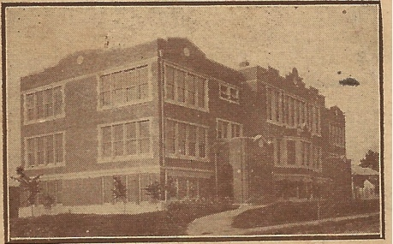
The Civil War in Education
Why we should loose the bonds of enslavement to the Progressive Agenda and the National Education Association

Slide 2
A look at the past
The Elementary and Secondary Education Act of 1965 was passed by President Lyndon Johnson as a part of his War on Poverty. While well-intentioned it is an extensive bill that controls funds for elementary and secondary education. The Department of Education became the dispenser of funds. They tied funds to curriculum.
Around the same time education became centralized,1968, Kenneth Goodman wrote “Reading: A Psycholinguistic Guessing Game.” Young Americans and generations of immigrants had learned to read by the phonics based Blue Back Speller written by Noah Webster and now “guessing” became an accepted methodology.
Those of the same philosophical ilk as Goodman, also editor of the Whole Language Catalog and a president of the International Reading Association, gained control of the Department of Education. They assured politicians that their methods of educating our newly integrated schools would best bring about the social change necessary for our schools. Their methods degraded the education of ALL CHILDREN and literacy took a dive.

Slide 3
Current Wisdom
The inability of students in my classes to read their middle school textbooks led me to a study of reading curriculum. At that time Whole Language was the method of instruction. Many of my students who had made A’s and B’s on their report cards throughout elementary school could not decode unfamiliar words in their secondary textbooks.
I attended a group meeting at a local high school where I asked Dean Richard Kunkel of Auburn University’s College of Education for some research supporting Whole Language. He told me that he could not. “It is Current Wisdom,” he said.
Without empirical data to support the effectiveness of this method, using only affective studies as support, the schools transformed to accommodate this “methodology.” Current wisdom. And the consequence has been devastating.
With Department of Education money tied to curriculum our entire country experienced a total contamination of this devastating curriculum. The Whole Language Philosophy expanded far beyond merely reading instruction.

Slide 4
“Once You Learn to Read You Will Be Forever Free.” Frederick Douglas
And yet, those who claimed to be the greatest advocates for these children, undermined their greatest opportunity to be successful! They controlled the Department of Education. They controlled the purse strings. They determined curriculum. And their purpose was not educating children, but socializing children.
The Brazilian Paolo Frere was offered a visiting professorship at Harvard University in 1969. Frere writes:
* "All instances of education become political acts.”
Freire's work influenced the so-called "radical math" movement in the United States, which emphasizes social justice issues and critical pedagogy as components of mathematical curricula.

Slide 5
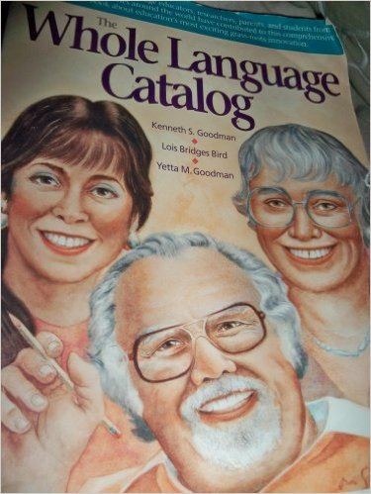
Philosophical basis of Progressive Education
Liberation Pedagogy is how these very influential educators see the process of teaching. They express this in their own words in the manifesto of the Progressive Education, the Whole Language Catalog. n 1967, Freire published his first book, Education as the Practice of Freedom. He followed this with his most famous book, Pedagogy of the Oppressed, first published in Portuguese in 1968.
On the strength of reception of his work, Freire was offered a visiting professorship at Harvard University in 1969.
Paulo Freire is a defrocked Marxist priest who once advocated liberation theology in Nicaragua, wrote and is now a philosopher of whole language advocating liberation pedagogy.
* Quoted from The Whole Language Catalog," Frere writes: "Politics is the soul of education."
* "All instances of education become political acts.”

Slide 6
Frere’s influence
Since the publication of the English edition in 1970, Pedagogy of the Oppressed has achieved near-iconic status in America's teacher-training programs, according to Sol Stern, a social commentator critical of the entry of Freire's Marxist-inspired teachings into the mainstream curriculum.
Michael Apple writes:
* WL "self-consciously connects itself to political, economic and cultural issues," it is destined to come into opposition to "the political right of the United States " (Apple, 1991, p. 416).
Take note of the dates of all of these events. The late sixties. The time of a revolution in education.

Slide 7
Behavior models Attitudes and Beliefs
Educators discovered that manipulating behavior molded attitudes and beliefs (Pavlov). That was when education shifted from Traditional to Progressive.
Desks were shifted to having desks face (co-operative learning/group learning/peer tutoring) with teachers as the “Guide on the Side," making the group Alpha, from having desks in straight rows encouraging Individualism) with teachers as the Authority in the classroom (now derogatorily referred to as the “Sage on the Stage.”)
Just so you know, since the mid sixties, contrary to the belief of parents and the public at large, the mission of our schools has not been academic achievement. Social Engineering has been the goal of the National Education Association and Progressive Educators.

Slide 8
Example of modeling attitudes and beliefs: Southern Manners
When a parent teaches a child to stand when an adult enters the room, say yes ma'am/sir, no ma'am/sir, please and thank you, to give up a seat on a bus or in the living room to a guest or elder, that a young man should stand should a woman comes to a table in a restaurant and continue to stand until that woman leaves, and to bow his head when grace is said, that parent has begun modeling the attitudes and beliefs of that child. The child is taught respect for authority and his elders, as well as self-discipline.
Behavior models attitudes and beliefs.

Slide 9
Difference between Traditional Education and Progressive Education
Traditional Education | Progressive
Teacher directed | Guide on the side
Desks directed toward teacher encouraging respect for authority | Desks arranged so that children face each other
Direct instruction | Group/Co-operative learning
Sequential instruction | Thematic instruction
Systematic, Intensive, Direct and Early (SIDE) Phonics for teaching reading | Whole Language “guessing”
Moral education | Values Clarification
Empirically proven traditional education | Current wisdom
“Stand on the shoulders of giants” | Experiential learning (reinvent the wheel rather than learning from others)

Slide 10
Thematic Instruction
Thematic education (taking issues in education from which to extract writing, literature, science, events, whole to part) supplanted the traditional method.
The Traditional method used for thousands of years utilized chronology in developing a formative understanding of our past and a foundational, sequential understanding of Science, Math and English.
History became Social Studies studied only as a part of a theme. For example: The bombing of Hiroshima and Nagasaki. Students lose the import of the sequence of events that led up to that event and study only the morality of the event, diminishing for the need for that choice purposefully undermining respect for our country.
As a teacher with a degree in History, I saw this happen personally.

Slide 11
Values Clarification
When God and the Bible were cast out Carl Rogers and Abraham Maslow's values clarification came in. Both Maslow and Maslow’s associate William Coulson realized theyhad created a monster and campaigned to stop what they called nondirective education.
“The court finds that Secular Humanism is a religion for Establishment Clause purposes,” the ruling read.
On Thursday, October 30, Senior District Judge Ancer Haggerty issued a ruling on American Humanist Association v. United States, a case that was brought by the American Humanist Association (AHA) and Jason Holden, a federal prisoner.

Slide 12
Only God was removed from our schools. Humanism became the new religion of our schools.
The “human potential movement,” which followed Carl Rogers’ and Abraham Maslow’s work, led to many new approaches in education. Our children became its guinea pigs.
The Association of Humanistic Psychology and the Association of Humanistic Education are international groups that sponsor publications, conferences, and professional collaboration, a method of reinforcing the credentials of professionals by publishing and promoting those of like mind.
New educational techniques have been developed by these humanistic practitioners, including “encounter groups,” values clarification exercises, self-esteem enhancement programs, guided imagery and visualization practices.

Slide 13
Values Clarification Repudiated by founders
According to Maslow's hierarchy of needs, self-actualization is of paramount importance for an individual's sense of fulfillment.
Roger's nondirective therapy emphasizes self-empowerment by encouraging individuals to center exclusively on their own inner desires, which often means rebelling against any type of authority figure, frequently resulting in a genuine disobedience to all legitimate forms of authority.
Both Maslow and Rogers repudiated their former teachings in the latter stages of their lives and distanced themselves from educational programs based on their theories and practices. They viewed the consequences on classrooms across the country. Associate William Coulson took as his life’s work.
The DARE program utilizes these methods and use of entry level drugs, alcohol and marijuana has increased.

Slide 14
Illiteracy is the result
According to a study conducted in late April by the U.S. Department of Education and the National Institute of Literacy, 32 million adults in the U.S. can’t read. That’s 14 percent of the population. 21 percent of adults in the U.S. read below a 5th grade level, and 19 percent of high school graduates can’t read. (Huffington Post, 2014)
According to the National Center for Educational Statistics in the United States: Over 60% of adults in the US prison system read at or below the fourth grade level. 85% of US juvenile inmates are functionally illiterate.
According to the Department of Justice, “The link between academic failure and delinquency, violence, and crime is welded to reading failure.” Over 70 percent of inmates in America’s prisons cannot read above a fourth grade level, according to BeginToRead.com. (Huffington Post,2014)

Slide 15
The Consequence of Progressive Education
With the social tumult of the 60s the Department of Education was founded and peopled with those intent upon succeeding in bringing about a social revolution. As a result of the condescension of the group who gained control, using our schools as cultural laboratories, those children this ideology was most intended to help have been those most harmed as reported by Michael S. Brunner at the Instigation of Robert Sweet (now director of the Right to Read Foundation) of the Justice Department.

Slide 16
Requirements for Teaching Must Take Credentialing Away from the NEA
1. Require that anyone who wants to teach school have a degree in a subject area, a discipline, like Math, Science, English, Math, History.
2. Those who want to be teachers should be able to produce references from respected members of the applicant's community and the teachers in the college from which he has earned a degree. They should reflect the highest moral character as well as competence in a discipline. Perhaps someone with a "disciplined" mind will be able to speak out like the little boy who decried the Emperor's New Clothes and actually call those failed "innovations" of Progressive Education exactly what they are...failed. It is time to call for curriculum with substance and not pretense.

Slide 17
Marva Collins thought every child could learn
Black educator Marva Collins succeeded in her inner city Chicago private school because she saw potential excellence in every child and took "learning disabled," "hyperactive," "ADD", et. al. and actually taught them using phonics to teach reading and a traditional curriculum!
Every child deserves the opportunity that those students in Marva Collins’ schools. That will only happen with private and charter schools freed from the curriculum of public schools unfettered by the control of the NEA.

Slide 18
Block Scheduling is an example of how “current wisdom” insinuates itself into our schools
When I heard of block scheduling coming to the high school our daughter would be attending, I researched the topic and found a study by Dr. David Bateson done on a group of over 20,000 students who had used the block scheduling method for about 20 years. His conclusion: Block Scheduling is "detrimental to academic achievement" too much material in (too little time for repetition and reinforcement). We contacted the professor personally and got his study which we then presented to our administration.
The result was that at the parents meeting held to present and perhaps adopt this "innovation" the information was withheld from the public. The parents group revved up by cheerleaders (those supervisors who visited a school that had just adopted block scheduling) approved the "innovation." Eventually, the academic supervisor used our children as the subject of her dissertation. She went on to become Superintendent of another school district. Another supervisor published articles enhancing his career in professional journals. Glossy brochures were printed at taxpayer cost to promote the agenda throughout the Southeast. Teachers who had used the method only a couple of weeks became experts overnight and traveled to promote the concept, leaving their own classrooms to substitute teachers. It is now universally accepted that block scheduling is "detrimental to academic achievement." And my community, funded by my tax dollars, is the "expert" that helped spread the contagion.

Slide 19
Choice in Schools Will Set Our Children Free
Walter Williams, TNI interview by Sara Penz, March 2006
George Will wrote a column earlier this year about teacher education. They’re not necessarily worrying about academic proficiency of teachers, but about how the teachers feel about social justice and white privilege and things like that. I’m thoroughly convinced that one of the best things we could do for primary and secondary education is to get rid of schools of education on college campuses, because schools of education on almost any college campus represent the intellectual slums of the campus. If you look at the students who become education majors—and the statistics are available from the National Center for Education Statistics—the high school students who intend to become education majors have the lowest SAT scores of any other major. And when these people graduate with a B.A., and some of them want to go to law school and take the LSAT, or to medical school and take them MCAT, or to graduate school and take the GRE, they score the lowest of any other major.
And so we have people in education who have very, very limited thinking ability, which makes them easy prey for all kinds of schemes that don’t make sense.

Slide 20
So How Do We Fix Our Schools? Look outside the box.
A group of women were walking by a river when they saw a large number of children struggling in the current being swept downstream. The women formed a human chain pulling the children from the current, yet many continued to drift toward the falls.
One woman broke away from the chain and headed back up the river.
"Where are you going? There are so many! We need your help!"
She responded, " I am going to find out who is throwing them in!"

Slide 21
We must no longer look to those who caused the problem to fix the problem!
Those who can-- DO. Those who can’t-- TEACH. Those who can’t teach --TEACH TEACHERS.
Match aspiring teachers with "Master Teachers" for an APPRENTICESHIP in education that would take the place of useless education courses.
Education courses do not create a Master Teacher. A Master teacher would be one whose students' scores on standardized tests progressed well from the beginning of the year to the end of the year. Acquiring the designation "Master Teacher" would not be a personality contest, nor an affective evaluation by those who have caused the problem on how well teachers have internalized their progressive teaching methods. It would be fact and results based with objective criteria. By example, aspiring teachers would learn effective discipline and teaching methods from an experienced mentor...and would discover whether or not they had the stuff it takes to be a good teacher.
.

Slide 22
Master Teachers Must Conform
Must use thematic education
Must use group learning
Must use experiential learning
Encourage risk taking
Legislators are told that Master Teachers and more money are the answer. Then why hasn’t the money already thrown at education made a difference? It is the basics of education philosophy and the monopoly of a contingent of radicals that has undermined education!

Slide 23
AT LAST with choice we have an opportunity to produce proficiency: Lost Tools of Learning by Dorothy Sayers
Has it ever struck you as odd, or unfortunate, that today, when the proportion of literacy throughout Western Europe is higher than it has ever been, people should have become susceptible to the influence of advertisement and mass propaganda to an extent hitherto unheard of and unimagined? Do you put this down to the mere mechanical fact that the press and the radio and so on have made propaganda much easier to distribute over a wide area? Or do you sometimes have an uneasy suspicion that the product of modern educational methods is less good than he or she might be at disentangling fact from opinion and the proven from the plausible?
http://www.gbt.org/text/sayers.html With choice, children might have an opportunity to experience this type of instruction. Example of such a school: https://www.providencechristianschool.com

Slide 24
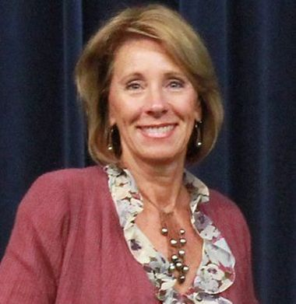
Please
Support Choice!

